Slide 1
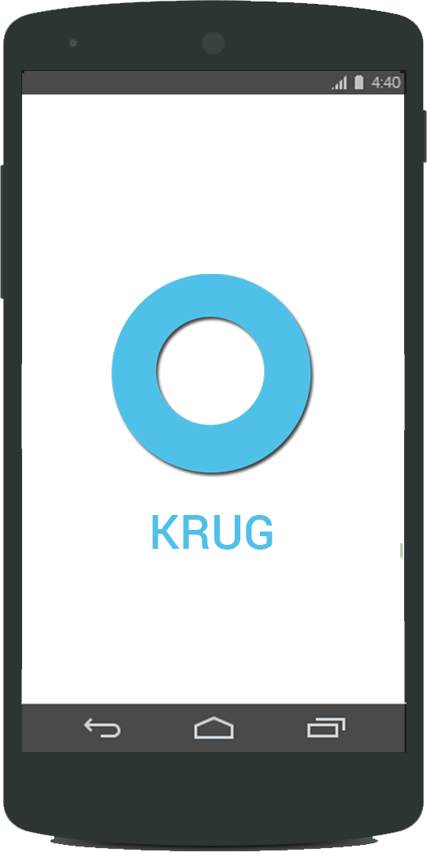
Intelligent Multi Chain Retail Shopping Assistant
Team Members
Gaurav Shenoy
Presha Thakkar Pramod Nagarajarao

Slide 2
Objective
To design a prototype of a mobile application to enhance the user’s shopping experience by integrating “KRUG”, a NLP/AI agent to the classical User Interface.

Slide 3
Problem Statement
To build a prototype of a mobile application for multi chain retail brand which has a NLP/AI agent which would learn from customer interaction and provide a customized user experience.
The application would track the user activities and would provide user with suggestions corresponding to his/her requirements.
The application gives “Shop in store” and “Online shopping” options to the user to shop from.

Slide 4
Software’s used
The software’s used to create the mock-ups for the
application are:
Balsamiq
Adobe Photo Shop
Invisionapp
Stupeflix

Slide 5
KRUG’s Key Functionalities
Hands free navigation – The user can navigate through the entire app hands free, which reduces the short-term memory load.
Internal locus of control is given to the user by giving the user, an option to input crucial and sensitive information.
The NLP/AI agent carries feedback from the user and generates an Intelligent /“Smart List”.

Slide 6
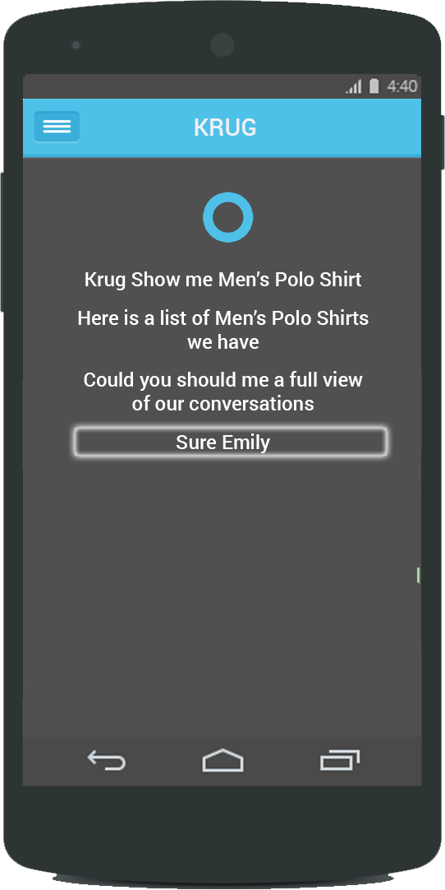
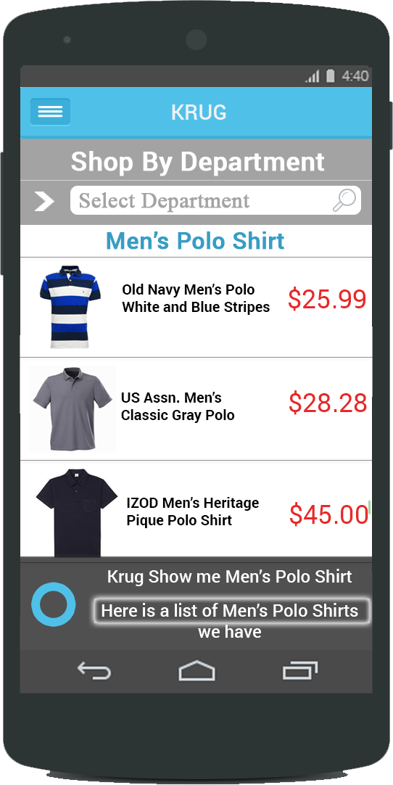
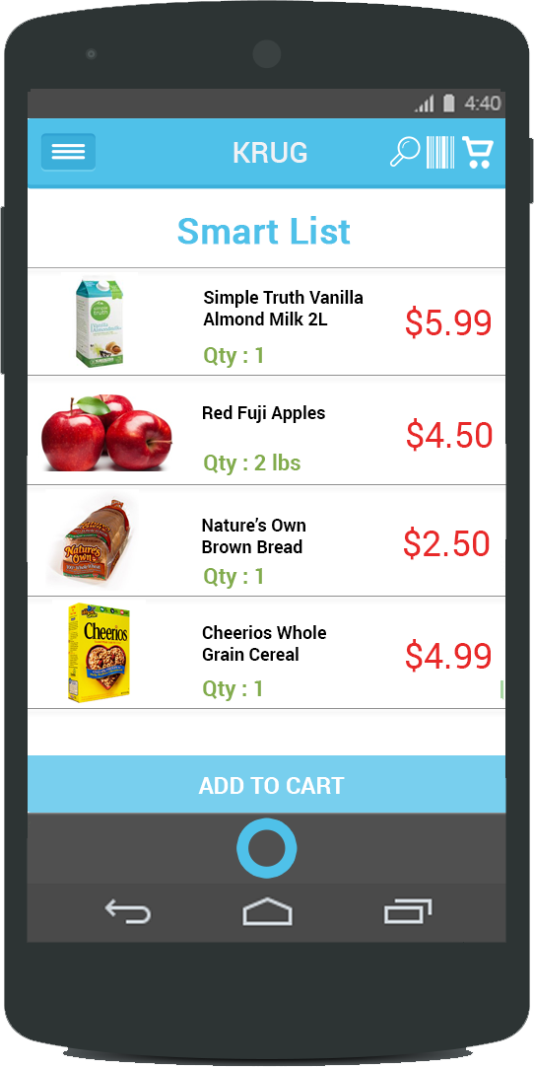
Modes of operation - “Krug”
Full mode with voice navigation
Hybrid mode
Normal mode

Slide 7

KRUG voice navigation demo

Slide 8
Demo of the App
https://projects.invisionapp.com/d/main#/console/3361295/73817677/preview

Slide 9
Design Evaluations
Strive for Consistency
Cater to universal Usability
Offer informative feedback
Design dialogs to yield closure
Prevent errors
Permit easy reversal of actions
Support internal locus of control.
Reduce short-term memory load.

Slide 10
Future Enhancements
Detection of user sentiment and context based response.
Integration with the restaurants and café’s present in the retail outlet with the application.

Slide 11
Questions and comments

